Slide 1
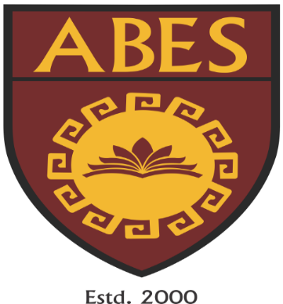
Smart Healthcare Assistant: AI-Driven Disease Diagnosis and Treatment Recommendation
ABES Engineering College, Ghaziabad, UP
Department of CSE-AIML
Project Presentation-3
Project
Domain: Data Science
Project Group No: CSE-AIML24-B3
PROJECT GUIDE: MS. DEEPALI DEV
TEAM MEMBERS:
NIVEDITA SRIVASTAVA,2000321530082
SHISHIR DWIVEDI,2000321530108
VARUN RAWAL,2000321530125

Slide 2
Contents
Introduction
Project Objective
Requirements of Project
Data Flow Diagram
Flow Chart
Dataset
Existing Work related to Project
Reference

Slide 3
Introduction
Current healthcare practices often grapple with challenges like diagnostic errors and treatment disparities. Enter AI - a game-changer that harnesses machine learning and data analysis to address these issues innovatively. In this presentation, we'll explore how AI transforms disease diagnosis and treatment recommendations, bolstering medical professionals' efforts. From Convolutional Neural Networks (CNNs) for medical imaging to Natural Language Processing (NLP) for symptom analysis, AI equips models with the ability to analyze complex data and predict diseases with accuracy. By merging diagnostics with medical databases, AI also crafts personalized treatment strategies based on individual medical histories and genetic makeup. As we delve into real-world successes, we'll also acknowledge the ethical considerations and data privacy concerns tied to AI's integration into healthcare. In conclusion, this journey will unveil the potential of AI to redefine healthcare - where human expertise meets AI's capabilities to chart a path toward improved patient outcomes and enhanced medical decision-making.

Slide 4
Problem Statement
Current healthcare practices often grapple with challenges like diagnostic errors and treatment disparities. Enter AI - a game-changer that harnesses machine learning and data analysis to address these issues innovatively. In this presentation, we'll explore how AI transforms disease diagnosis and treatment recommendations, bolstering medical professionals' efforts. From Convolutional Neural Networks (CNNs) for medical imaging to Natural Language Processing (NLP) for symptom analysis, AI equips models with the ability to analyze complex data and predict diseases with accuracy. By merging diagnostics with medical databases, AI also crafts personalized treatment strategies based on individual medical histories and genetic makeup. As we delve into real-world successes, we'll also acknowledge the ethical considerations and data privacy concerns tied to AI's integration into healthcare. In conclusion, this journey will unveil the potential of AI to redefine healthcare - where human expertise meets AI's capabilities to chart a path toward improved patient outcomes and enhanced medical decision-making.

Slide 5
Project Objectives
Improve Diagnostic Accuracy: Develop AI algorithms that can accurately analyze medical data, symptoms, and patient history to provide more precise and timely disease diagnoses. The goal is to reduce instances of misdiagnosis and enhance patient outcomes.
Reducing Healthcare Workload: Design an AI system that can handle routine tasks, such as gathering patient information, generating reports, and providing general health information. This can free up healthcare professionals' time for more complex and critical aspects of care.
Multilingual Support: Ensure that the AI system can provide information and recommendations in multiple languages to accommodate diverse patient populations and healthcare professionals.

Slide 6
Requirements of Projects
Language: Python
Dataset sources:
Kaggle
Hugging Face
Technology Used:
Lamma 2
Langchain
Gradio

Slide 7
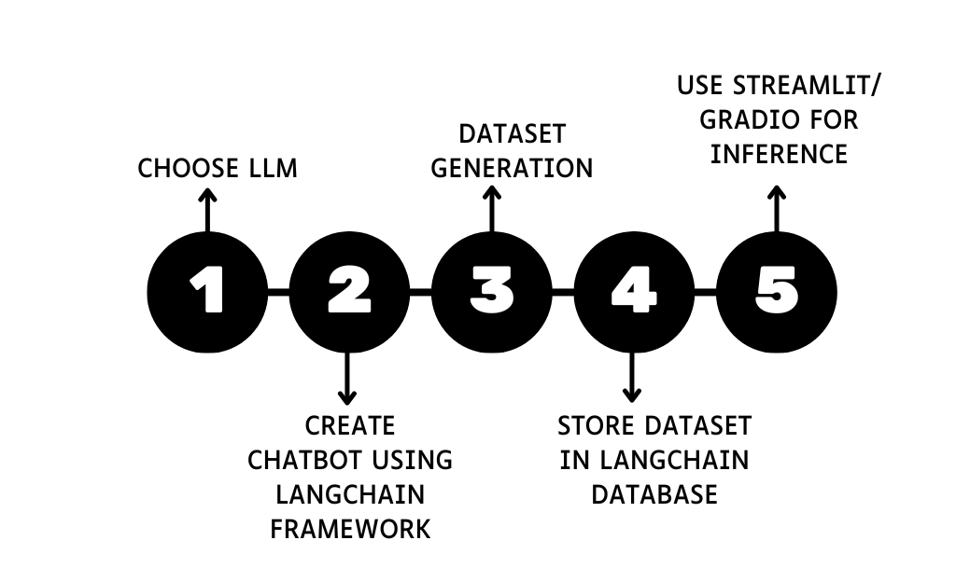
Work Flow Diagram

Slide 8
RESEARCH REVIEW
Work | Year | Author | Results
Llama2-Medical-Chatbot | September 2023 | manjunathshiva | This is a medical bot built using Llama2 and Sentence Transformers. The bot is powered by Langchain and Chainlit.
Health-Bot (Healthcare Chatbot) | November 2021 | Sanket Muchhala, Avisha Jain, Sudhanshu Rai | Multinomial Naive Bayes is used algorithm for text classification and NLP used for chatbot. Datasets for AI chatbot (HealthBot): Dataset for disease and their symptoms
Healthcare Chatbot using Natural Language Processing | April 2020 | Papiya Mahajan, Rinku Wankhade, Anup Jawade, Pragati Dange, Aishwarya Bhoge | The application is developed for obtaining a fast response from the bot which implies with none delay it provides the correct result to the user.
Intelligent Healthbot for Transforming Healthcare | April 2019 | Vivek Katariya, Prof. Vitthal S Gutte | Based on Machine Learning and Artificial Intelligence techniques, the chatbot is able to overcome the limitation of classical human-machine interaction, thus removing bias and allowing the patient to a free and natural communication.
MedChatBot: An UMLS based Chatbot for Medical Students | October 2018 | Hameedullah Kazi, B.S. Chowdhry and Zeesha | Focuses on a design for an AIML based Medical Chatbot. This Chatbot design is implemented using a JAVA based AIML interpreter called Chatter bean

Slide 9
Existing Works related to your Project
Buoy Health: Buoy Health offers an AI-driven platform that helps users identify possible health conditions based on their symptoms. It guides users through a series of questions and then provides information on potential causes and recommended actions.
Ada Health: Ada Health is a mobile app that uses AI and natural language processing to help users understand their symptoms and potential health conditions. Users can input their symptoms, and the app provides a list of possible conditions along with advice on what to do next.
Your.MD: Your.MD is an AI-powered health assistant that offers information on symptoms, potential conditions, and self-care advice. It helps users understand their health concerns and provides recommendations for next steps.

Slide 10
Results

Slide 11
References
https://ai.meta.com/research/publications/llama-2-open-foundation-and-fine-tuned-chat-models/
https://docs.langchain.com/docs/
https://ai.meta.com/llama/
https://dataconomy.com/2023/07/19/meta-ai-what-is-llama-2-and-how-to-use/
Jain, Avisha & Muchhala, Sanket. (2020). Health-Bot (Healthcare Chatbot).
Rarhi, Krishnendu & Bhattacharya, Abhishek & Mishra, Abhishek & Mandal, Krishnasis. (2017). Automated Medical Chatbot. SSRN Electronic Journal. 10.2139/ssrn.3090881.
Katariya, Vivek & Vitthal, Shinde & Gutte, Vitthal & Devare, Manoj. (2019). Intelligent Healthbot for Transforming Healthcare.

Slide 12
Thank You !

